Slide 1


DS401 - Data Science Capstone
Analyzing service call data in Cerro Gordo County, IA
Notes:
Neha Maddali

Slide 2

Predict-Align-Prevent Model to Improve Health and Safety
Data Science Capstone
Team 1: Community Safety
Sponsor: Shawn Dorius
Instructor: Adisak Sukul
Pramit Vyas, Neha Maddali, Alexis Maldonado
Notes:
Neha Maddali

Slide 3


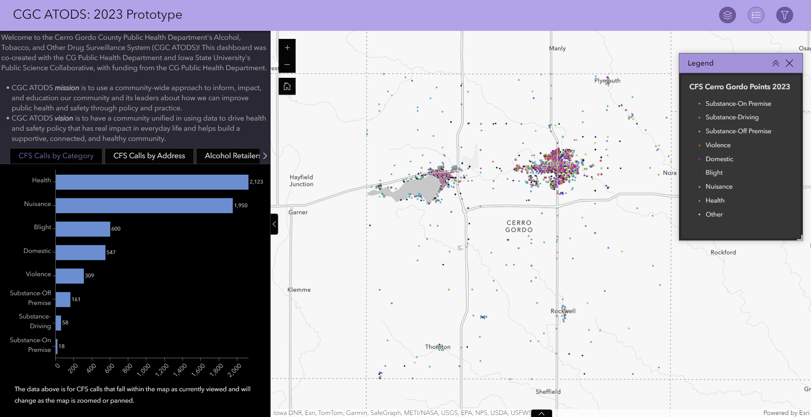
Project Overview
PREDICT WHEN AND WHERE TO
ALIGN RESOURCES
PREVENT THESE INCIDENTS
Notes:
Neha Maddali
- mention overview of PSC

Slide 4
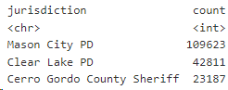
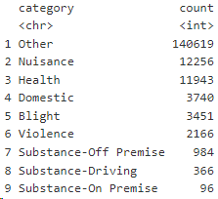
Data Overview
Cerro Gordo County call for service data from March 2018-2023
Data cleaning completed by client
Important variables
cfs_type and category
Time elements
Geospatial elements
Notes:
Pramit Vyas

Slide 5
Category Definitions
Nuisance: disturbances, noise complaints, parties, disputes
Health: medical, welfare checks
Domestic: verbal and physical domestic calls
Blight: damaged property, vandalism, abandoned vehicles, illegal dumping and littering
Violence: assault, robbery, sexual assault, armed subjects
Substance-Off Premise: not necessarily directly tied to a specific alcohol or tobacco retailer, such as public intoxication, underage liquor violations, drug activity and complaints, and tobacco law violations
Substance-Driving: intoxicated driver calls and OWI checks
Substance-On Premise: directly related to substance retailer, including liquor and tobacco compliance checks and violations
Notes:
Pramit Vyas

Slide 6
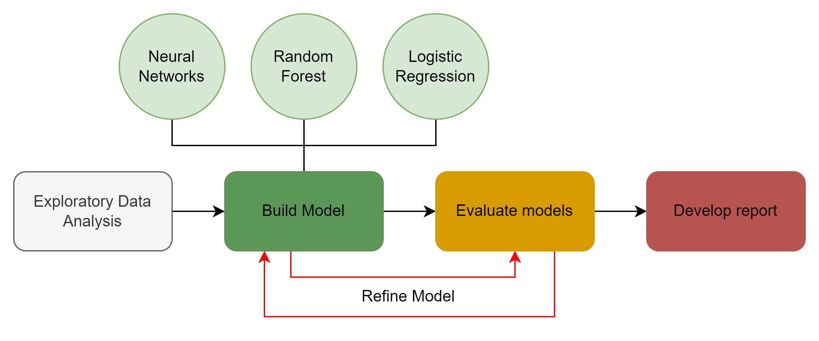
Project Overview - Workflow
WEEKS 1 - 8
WEEKS 9 - 15
Notes:
Neha Maddali

Slide 7
Techniques
R language
Data visualization for exploratory data analysis
Logistic Regression Model
train multiple models to make predictions with high levels of confidence
Random Forest Model
build many decision trees and combine their predictions
Neural Network Model
use non-linear activation function to connect neurons through layers for predictions
Notes:
Pramit Vyas

Slide 8
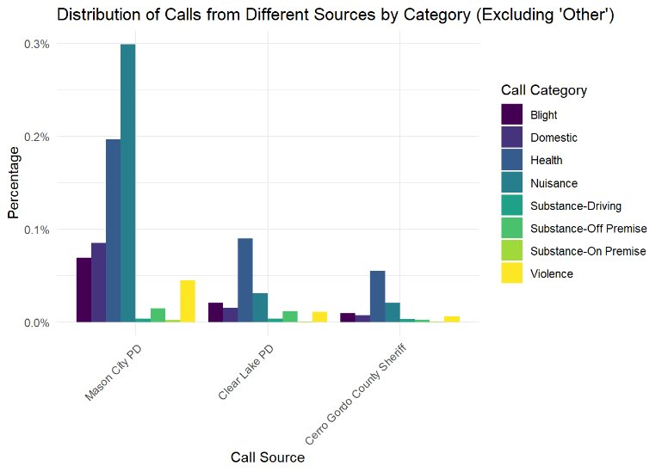
High-Level Overview of EDA
Figure 1: Distribution of the call service data among the 3 kinds of distinctions: Mason City PD, Clear Lake PD and Cerro Gordo County Sherriff
Notes:
Alex

Slide 9
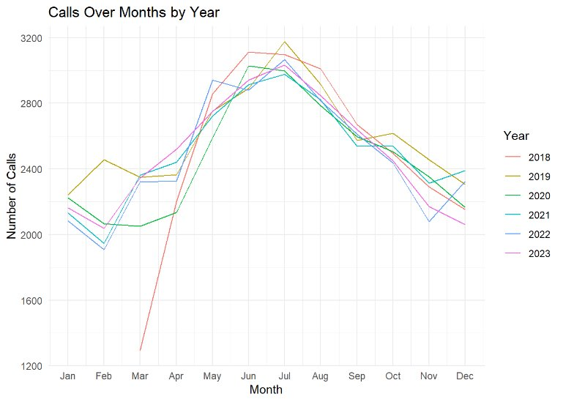
High-Level Overview of EDA
Figure 2: Time series of service calls over months of the years in data set.
Notes:
Alex

Slide 10
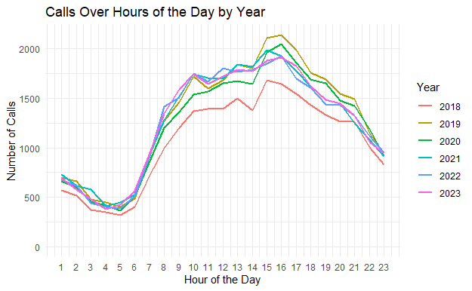
High-Level Overview of EDA
Figure 3: Time series of service calls over hours of the day by years in data set.
Notes:
Alex

Slide 11
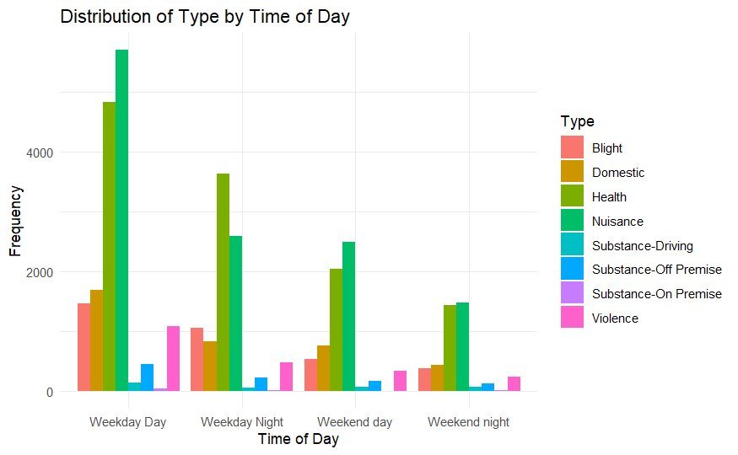
High-Level Overview of EDA
Figure 4: Distribution of type of call made by time of day categorized in weekday daytime, weekday nighttime, weekend daytime, or weekend nighttime.
Notes:
Neha

Slide 12
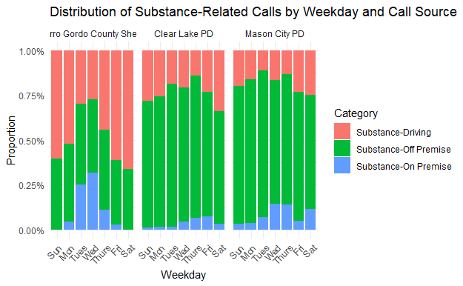
High-Level Overview of EDA
Figure 5: Distribution of substance related calls by weekdays and call source.
Notes:
Neha

Slide 13
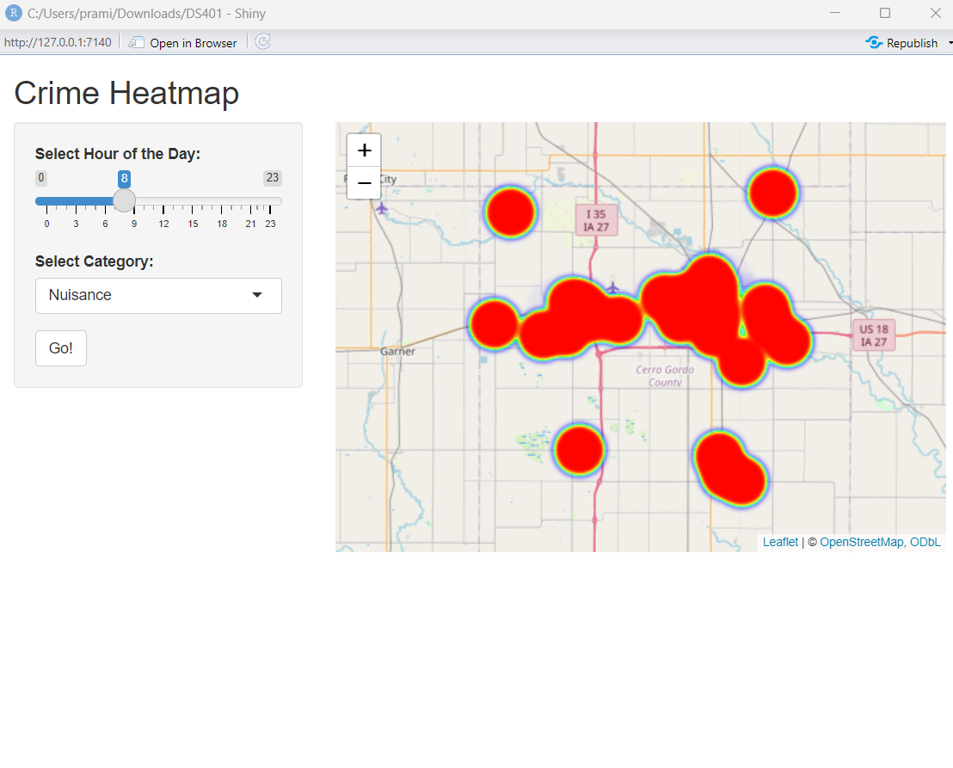
High-Level Overview of EDA R Shiny Dashboard
R Shiny Dashboard for heat maps of data with hour scroll bar, category selector.
Notes:
Pramit Vyas

Slide 14
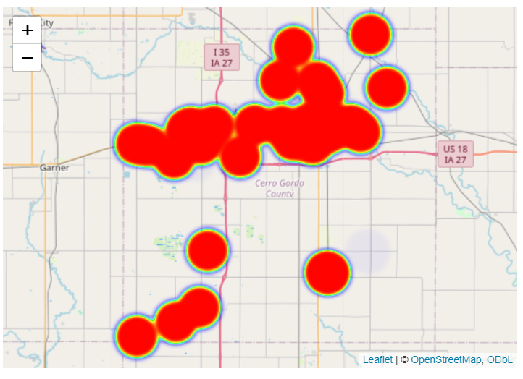
High-Level Overview of EDA
Figure 6: Heat map of Nuisance service calls within Cerro Gordo County at 8:00 am
Figure 7: Heat map of Nuisance service calls within Cerro Gordo County at 9:00 pm
Notes:
Pramit Vyas

Slide 15
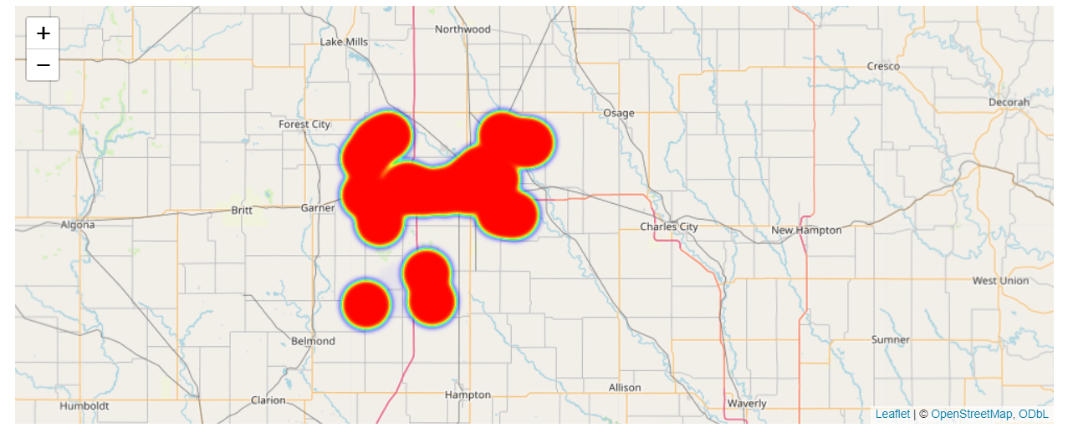
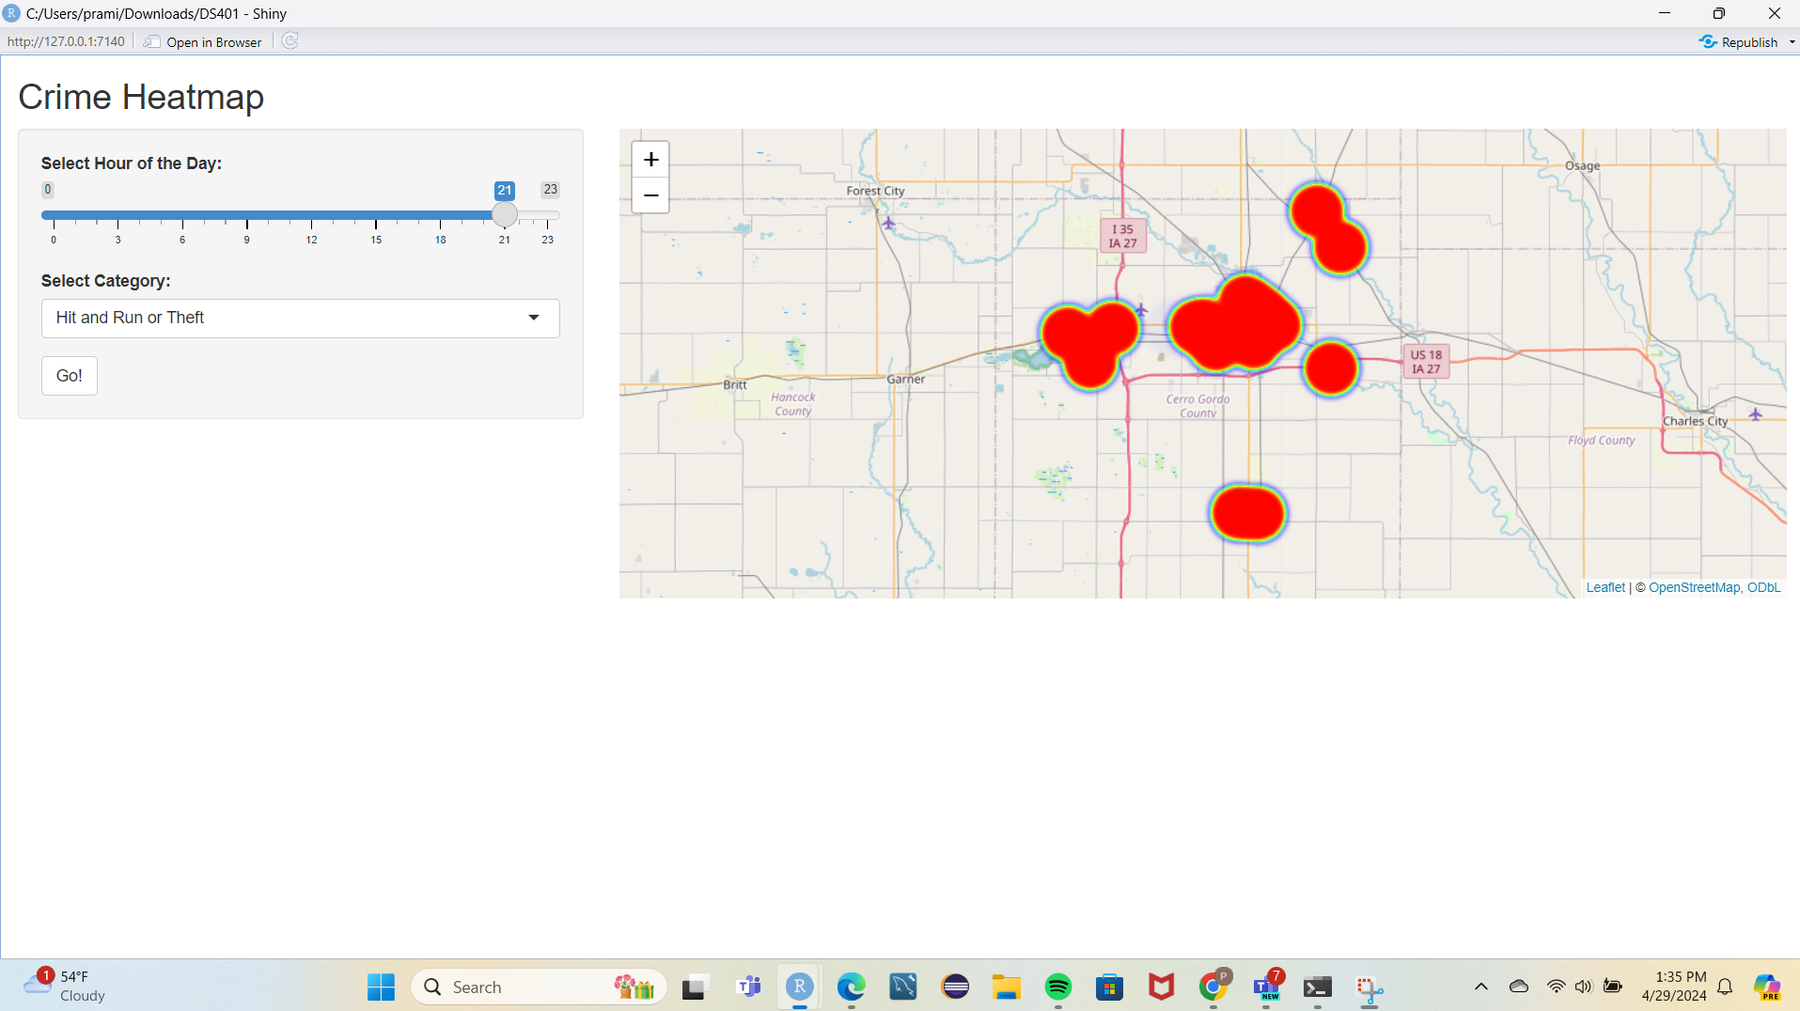
High-Level Overview of EDA
Figure 8: Heat map of Theft service calls within Cerro Gordo County at 8:00 am
Figure 9: Heat map of Theft service calls within Cerro Gordo County at 9:00 pm
Notes:
Pramit Vyas
redo graph on just theft/shoplifting

Slide 16
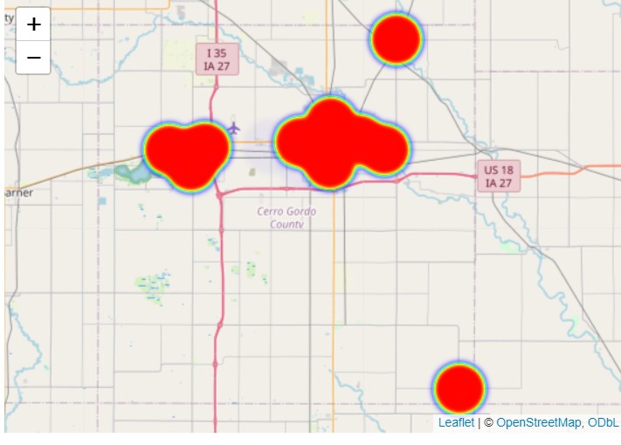
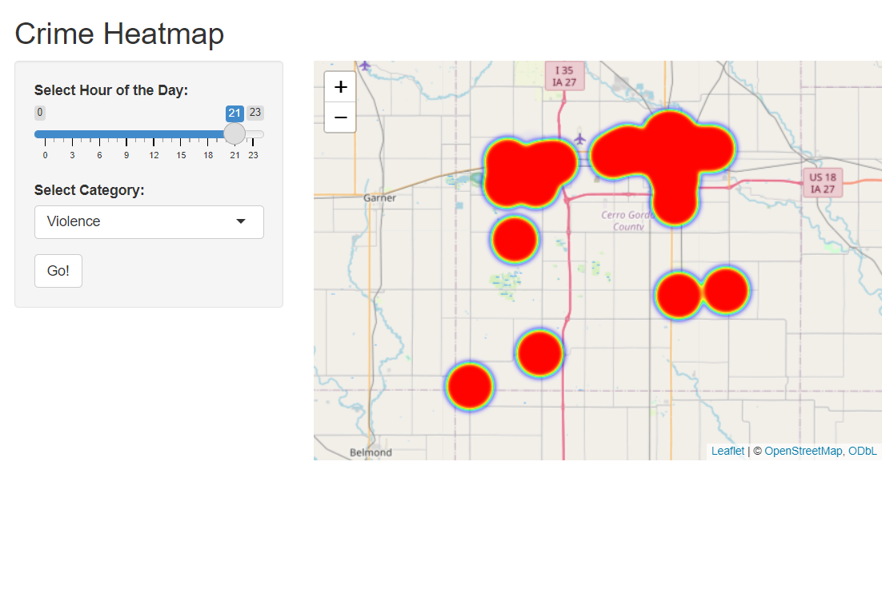
High-Level Overview of EDA
Figure 10: Heat map of Violence related service calls within Cerro Gordo County at 8:00 am
Figure 11: Heat map of Violence related service calls within Cerro Gordo County at 9:00 pm
Notes:
Pramit Vyas

Slide 17
Developing Models for Prediction
Disclaimer
All this work is exploratory and is new for this context of a smaller county and community with less data available compared to previous similar research
Notes:
Alex

Slide 18
Logistic Regression – Model Specifications
Logistic Regression model
Goal: Predict the presence of Theft and Shoplifting in block group
Data manipulation
Filtered cfs data from 2018-2022
Features used for final model
Block group
Hour
Day
Notes:
Alex

Slide 19
Logistic Regression – Model Building Process
Data Preparation
split data: 70% train, 30% test
Logistic Model
built initial model with most predictors
built the final model with significant predictors
Evaluation:
F1 Score
Accuracy
Confusion Matrix
Notes:
Alex

Slide 20
Logistic – Model Results
Final model: Ovall boost in accuracy level of 0.68 for Theft or Shoplifting in data with an F1 score of 0.81
 | Original Model | Final Model
Accuracy | 0.61 | 0.68
F1 Score | 0.75 | 0.81
 | Actual 0 | Actual 1
Predicted 0 | 28940 | 583
Predicted 1 | 13309 | 868
Notes:
Alex

Slide 21
Random Forest – Model Specifications
Random Forest Regression model
Goal: predict number of Nuisance calls per hour
Data manipulation
filtered cfs data from 2018-2022
Features used
Type
Year
Month
Hour
Day
Notes:
Neha

Slide 22
Random Forest – Model Building Process
Data Preparation
split data: 70% train, 30% test
Random Forest Model
built initial model with default hyperparameters
evaluated performance metrics
Hyperparameter Tuning
tuned model using cross validation (5 folds)
selected best mtry hyperparameter
Tuned Model: rebuilt model with tuned parameters
Bagging: applied to tuned random forest model
Evaluation: calculated Out-of-Bag error
Notes:
Neha

Slide 23
Random Forest – Model Results
Bagged model: on average, misclassifies 11.09% of category Nuisance observations in training data that weren’t used in the construction of the tree that made the prediction
 | Original RF | Tuned Model | Bagged Model
Mean Absolute Error | 0.2152 | 0.221 | 0.2212
Mean Squared Error | 0.1275 | 0.1334 | 0.1332
R² | 0.0202 | 0.01103 | 0.0115
Out of Bag Error |  |  | 0.1109
Notes:
Neha

Slide 24
Neural Networks – Model Specifications
Used single-layer Perceptron as baseline model in a classification task predicting whether a certain type of call will occur in a given hour
Ensembled it to make a multi-layer perceptron fully connected to build a simple neural network model, allowing numerical predictions
Progressed to Convolutional and eventually Recurrent Neural Network
Worked with subsetting to calls related to different types of crime
Settled with predicting violence related calls
Notes:
Pramit

Slide 25
Neural Networks – Model Specifications
Goal: Predicting number of violence calls for each hour for violence
variables used
Hour
Day
Month
Year
Lags
Notes:
Pramit

Slide 26
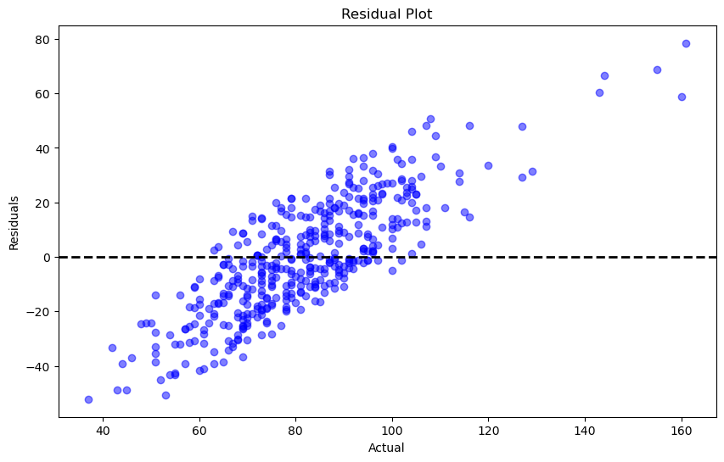
Neural Networks – Model Results
Model | MAE | Loss | Residual Plot
Single-Layer Perceptron | 2.66
Multi-Level Perceptron | 3.48
Convolutional Neural Network | 2.23 | 19.05
Recurrent Neural Network | 0.998
Notes:
Pramit

Slide 27
Overall Results
May – August peak frequency of calls throughout 2018-2023
4 PM peak frequency of calls throughout the days of 2018-2023
Logistic Regression
Hour, Day, Block group
Random Forest
Day and Hour most significant
Neural Network
Lag predictors, Hour, Day very significant
Notes:
Alex

Slide 28
Future Work – Next Steps
Develop new models in Logistic Regression, Random Forest and Neural Network
Predict call type based on data and geolocation
Use other subsets of data (Health, Violence, etc.)
Further tune models
Collecting more data
Some categories have less than 100 instances
Investigate the Impact of Police Shifts: analyze correlation between police shifts and incident reporting to understand how staffing levels influence reported incidents
Notes:
Alex
Talk about interaction between time, geospatial and category

Slide 29
Contact Us
Pramit Vyas
Pvvyas@iastate.edu
(515)-443-5484
Alexis Maldonado
ahm@iastate.edu
(319)-202-8952
Neha Maddali
nmaddali@iastate.edu
Notes:
New names

